Slide 1


PANIMALAR ENGINEERING COLLEGE
DEPARTMENT OF COMPUTER SCIENCE AND ENGINEERING
CS8811-PROJECT WORK
FINAL REVIEW
Diabetic Retinopathy-Optical Loss Detection using OCT image through Deep Learning
Guide Name: Mrs K.Sangeetha M.E.,
(Assistant professor)
Team Members with Register number
Balaji R (211418104034)
Gokul N (211418104067)
BATCH NO: E-24

Slide 2
Introduction:
Diabetic retinopathy is a disease that affects retinal or blood vessels present in the retina due to excess amount of glucose content.
Diabetic retinopathy can be classified into four stages starting from earliest stage to the most advanced stage after the examination of optical coherence tomography images of retina , namely CNV,DME DRUSEN and NORMAL.
CNN is designed more specifically for image processing and thus it is been widely used for the analysing and recognition of OCT images.
VGG16 network is used in our model for feature extraction and Relu activation function along with categorical cross-entropy function is used for classification of retina infected OCT image.

Slide 3
LITERATURE SURVEY:
AUTHORS | TITLE | YEAR | SOURCE | FINDINGS
Aryan Kokane, Gourhari Sharma, Akash Raina | Detection of Diabetic Retinopathy using Machine Learning | 2020 | IRJET | Failed to detect DR In early stage since fundus image had noise in it
Wejdan L.Alyoubi, Wafaa M.Shalash, Maysoon F.Abulkhair | DR detection through DL techniques: A review | 2020 | Informatics in Medicine Unlocked | CNN used in DR detection using fundus images
Yung-Hui Li , Nai-Ning Yeh, Shih-Jen Chen | Computer- Assisted Diagnosis for DR Based on Fundus Images | 2019 | Mobile information systems | Replace max- pooling layers with fractional max-pooling.Used SVM classifier
Suvajit Dutta, Bonthala CS Manideep, Syed Muzamil Basha | Classification of DR Images by Using Deep Learning Models | 2018 | International Journal of Grid and Distributed Computing | Model gave lowest accuracy due to hidden layer
T Chandrakumar, R Kathirvel | Classifying DR using Deep Learning Architecture | 2016 | IJERT | Model uses fundus image for classifying problem

Slide 4
Problem Statement:
Proper detection of diabetic retinopathy in early stage is extremely important to prevent complete blindness.
DR is developed when a patients has diabetes disease for atleast 10 years without prior treatment and not aware of it.
Manual identification of OCT images is a huge burden for the ophthalmologist since it requires accurate reading of those images through naked eye.
This disease identification task becomes even more challenging in developing countries where the number of qualified ophthalmologist are inadequate.
Hence deep learning model is used to automate entire process and to lessen the time ,effort and professional required for detecting the presence of diabetic retinopathy in early possible stage.

Slide 5
Hardware requirements:
Processor :Pentium Dual Core 2.00GHZ
Hard disk :120GB
RAM :2GB(minimum)
Keyboard :110 keys enhanced
Software Requirements:
Operating system :Windows7(with service pack 1),8,8.1 and 10
IDE : Visual studio code
Language :Python

Slide 6
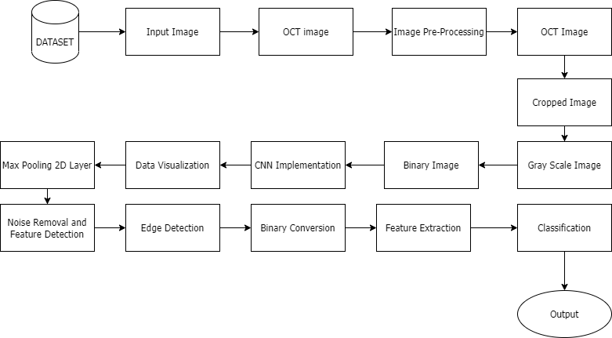
System Architecture:

Slide 7
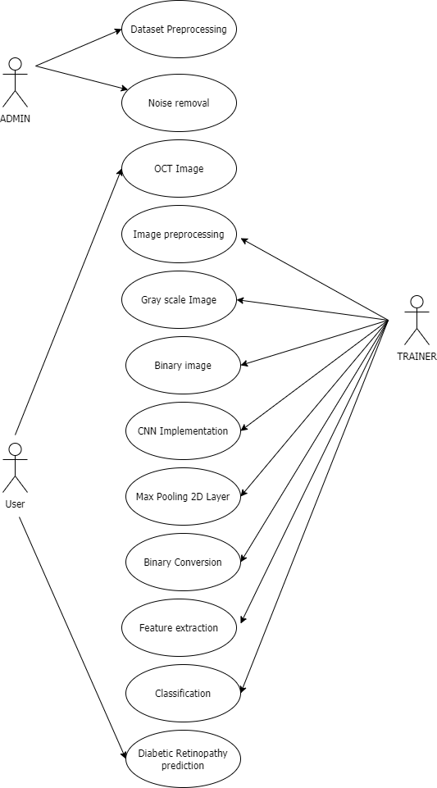
Use case Diagram:

Slide 8
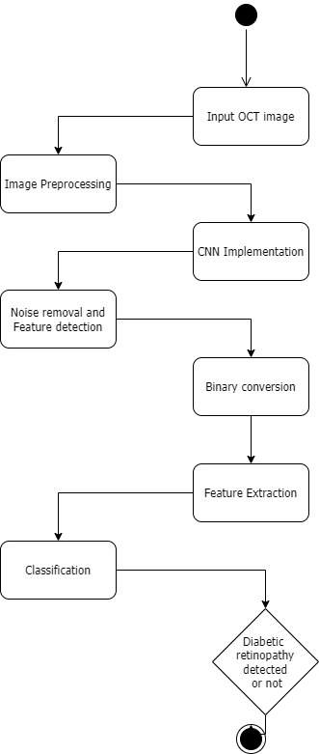
Activity Diagram:

Slide 9
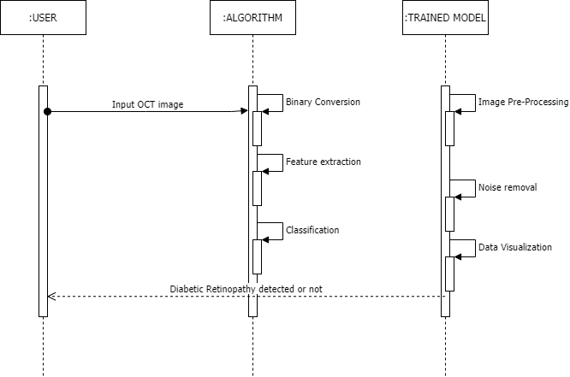
Sequence Diagram:

Slide 10

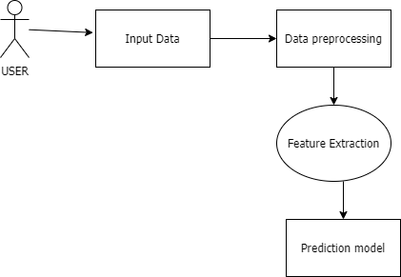
DFD LEVEL-0:
DFD LEVEL-1:

Slide 11
MODULE DESCRIPTION: INPUT INFECTED IMAGE:
The project proposed is a deep learning model which is used for identifying the stage of infection in the human eye in early possible stage.
The User Interface contains an option “choose file” , on selecting it will allow the user to give the infected image as input.
The user must contain their retinal OCT image in order to give it as input and get to know the stage of infection using our system.

Slide 12
Image Pre-processing:
Optical coherence tomography(OCT) images are high resolution images, contactless and non-destructive testing property.
A grayscale image is simply one in which the only colors are shades of gray. The reason for differentiating such images from any other sort of color image is that less information needs are be provided for each pixel.
Edge detection: Edge detection is an image processing technique for finding the boundaries of objects within images. It works by detecting discontinuities in brightness
A binary image is one that consists of pixels that can have one of exactly two colors, usually 0 for black and 1 or 255 for white.

Slide 13
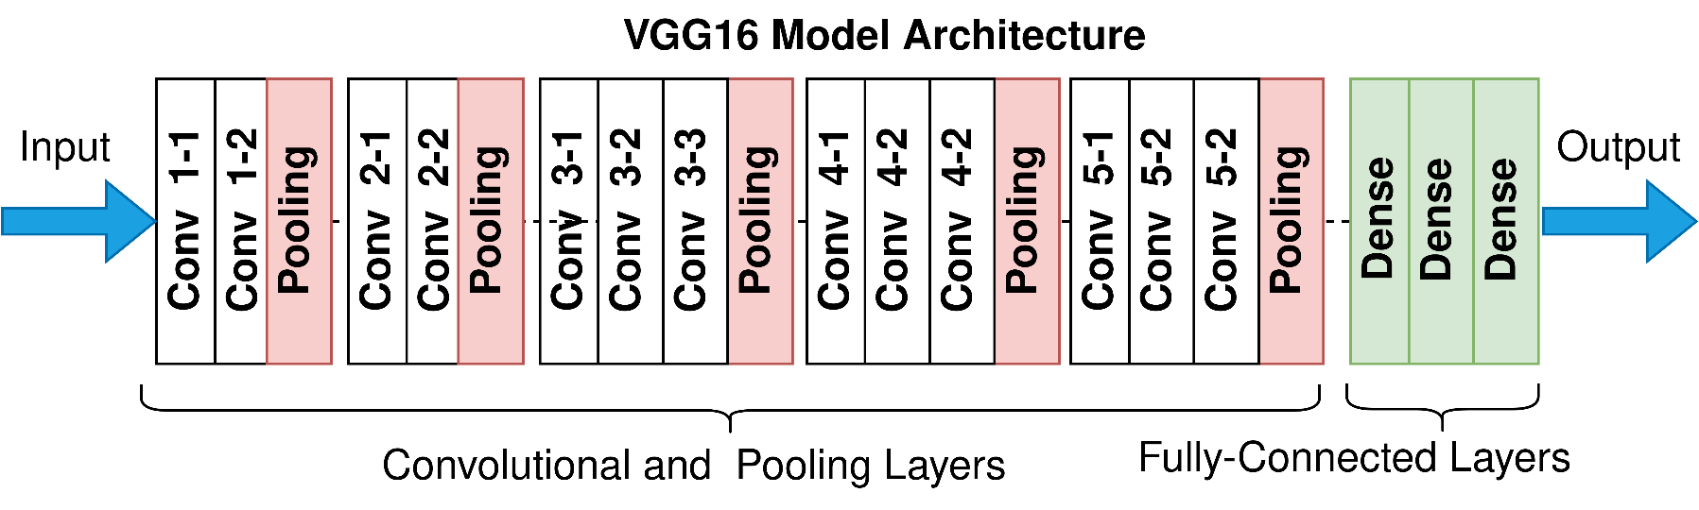
NETWORK SELECTION:
we have used VGG16 network for training our model which typically has 16 layers of which 13 are convolutional layers with same padding and stride 1 and 3 dense layers with stride 2.
Typically there are 21 layers in VGG16 network out of which only 16 are weight layers(i.e. Learnable parameters).
Fig 1.Architecture of VGG16 model

Slide 14
VGG16 - FEATURE EXTRACTION:
Deep learning is a subset of machine learning,which is essentially a neural network with number of layers.
Feature extraction is a part of the dimensionality reduction process, in which, an initial set of the raw data is divided and reduced to more manageable groups.
An input OCT image will be provided to our model . Later the image will be pre-processed and necessary features will be extracted later by VGG16 model.
VGG16 checks an image by blocks, starting from the left upper corner and moving further pixel by pixel up to a successful completion.
Then the result of every verification is passed through a convolutional layer, where data elements have connections while others don’t.

Slide 15
PREDICTING INFECTED IMAGE:
In our proposed model , we are classifying the Diabetic Retinopathy disease into 4 major categories namely:
DRUSEN
DIABETIC MACULAR EDEMA(DME)
CHOROIDAL NEOVASCULARIZATION(CNV)
NORMAL
Based on the data obtained after verification of the input infected image, the system can conclude what is in the picture.
After the user selects the predict button present in UI , the model displays the type of Diabetic Retinopathy.

Slide 16
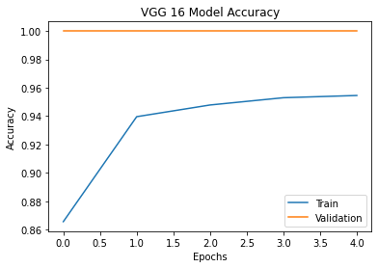
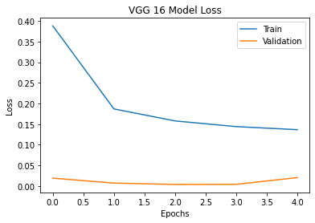
PERFORMANCE EVALUATION:
After training our model with dataset ,accuracy is found to be gradually increasing fig(a) and loss value is found to be sharply falling after some early stages fig(b).
fig(a)
fig(b)

Slide 17
RESULTS:
Thus from our proposed system, we are able to eliminate many complexities faced by conventional detection systems.
With the use of OCT image of infected retina rather than fundus images,lot of pre-processing steps are done in reduced time and classification is done quickly and more accurately.
The usage of VGG16 model and other activation functions and dropout layers, our proposed model’s accuracy for detection of the diabetic Retinopathy using OCT images is found out to be 95.46%.

Slide 18
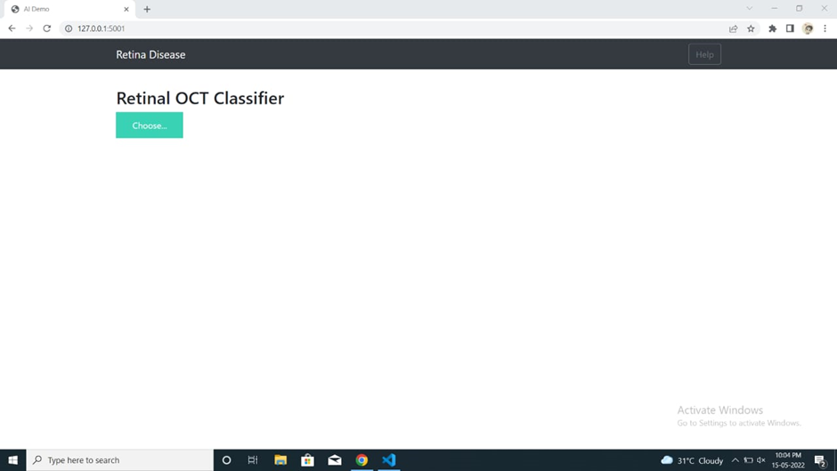
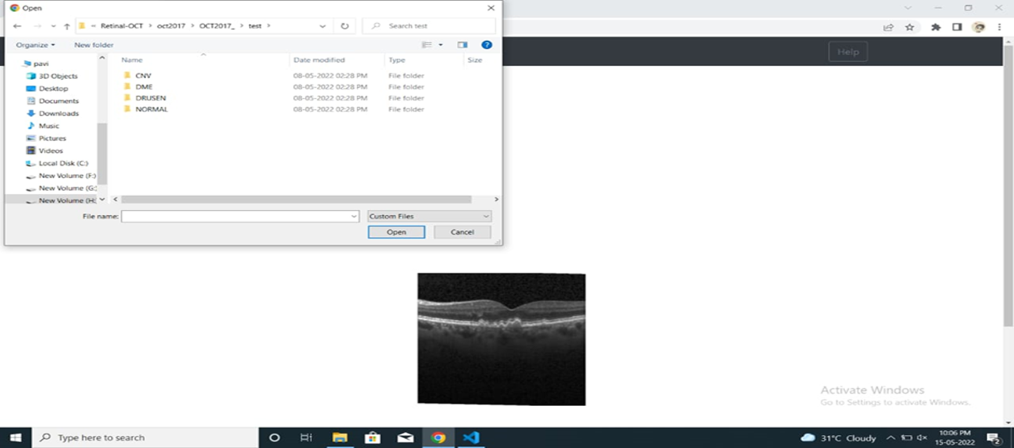
INPUT IMAGE:
Home Page
Image uploading UI

Slide 19
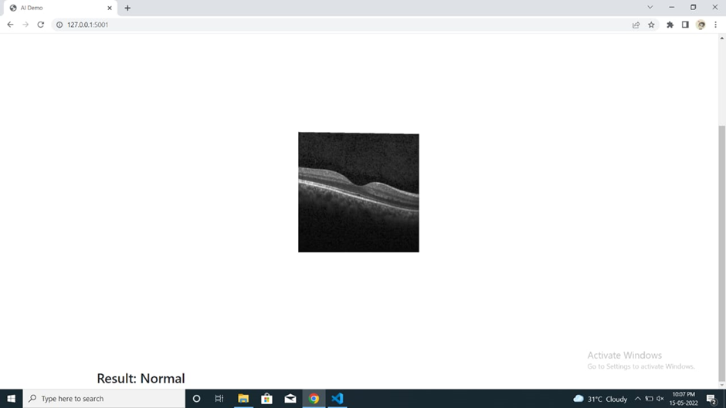
OUTPUT SCREENSHOT :
Normal DR Detected

Slide 20
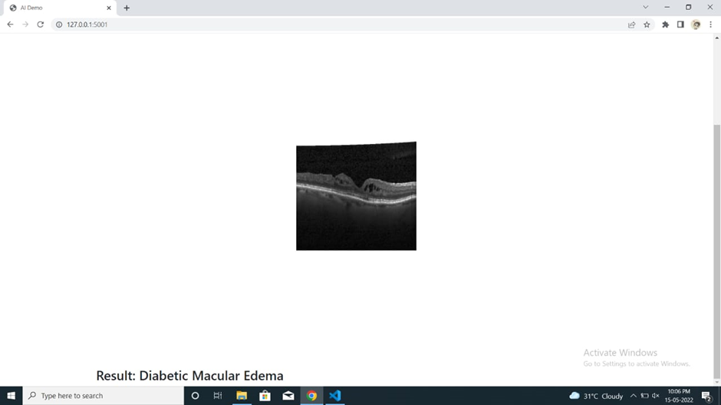
OUTPUT SCREENSHOT :
Diabetic Macular Edema Detected

Slide 21
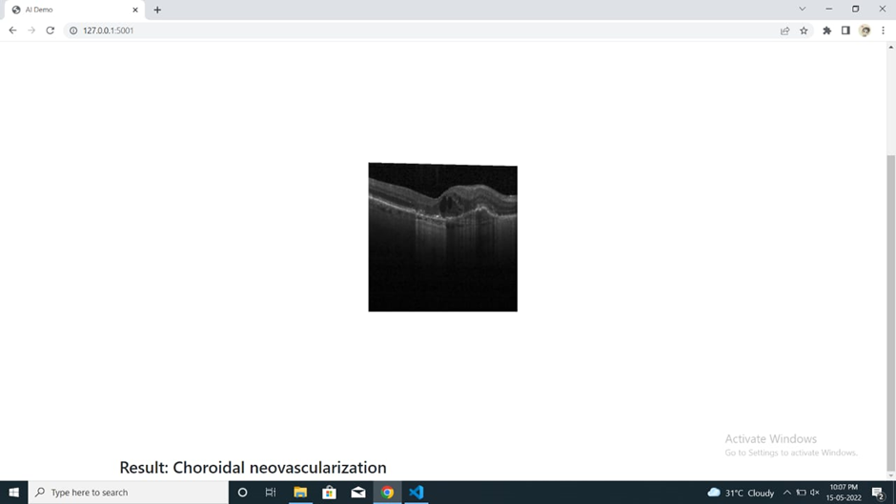
OUTPUT SCREENSHOT :
Choroidal Neovascularization Detected

Slide 22
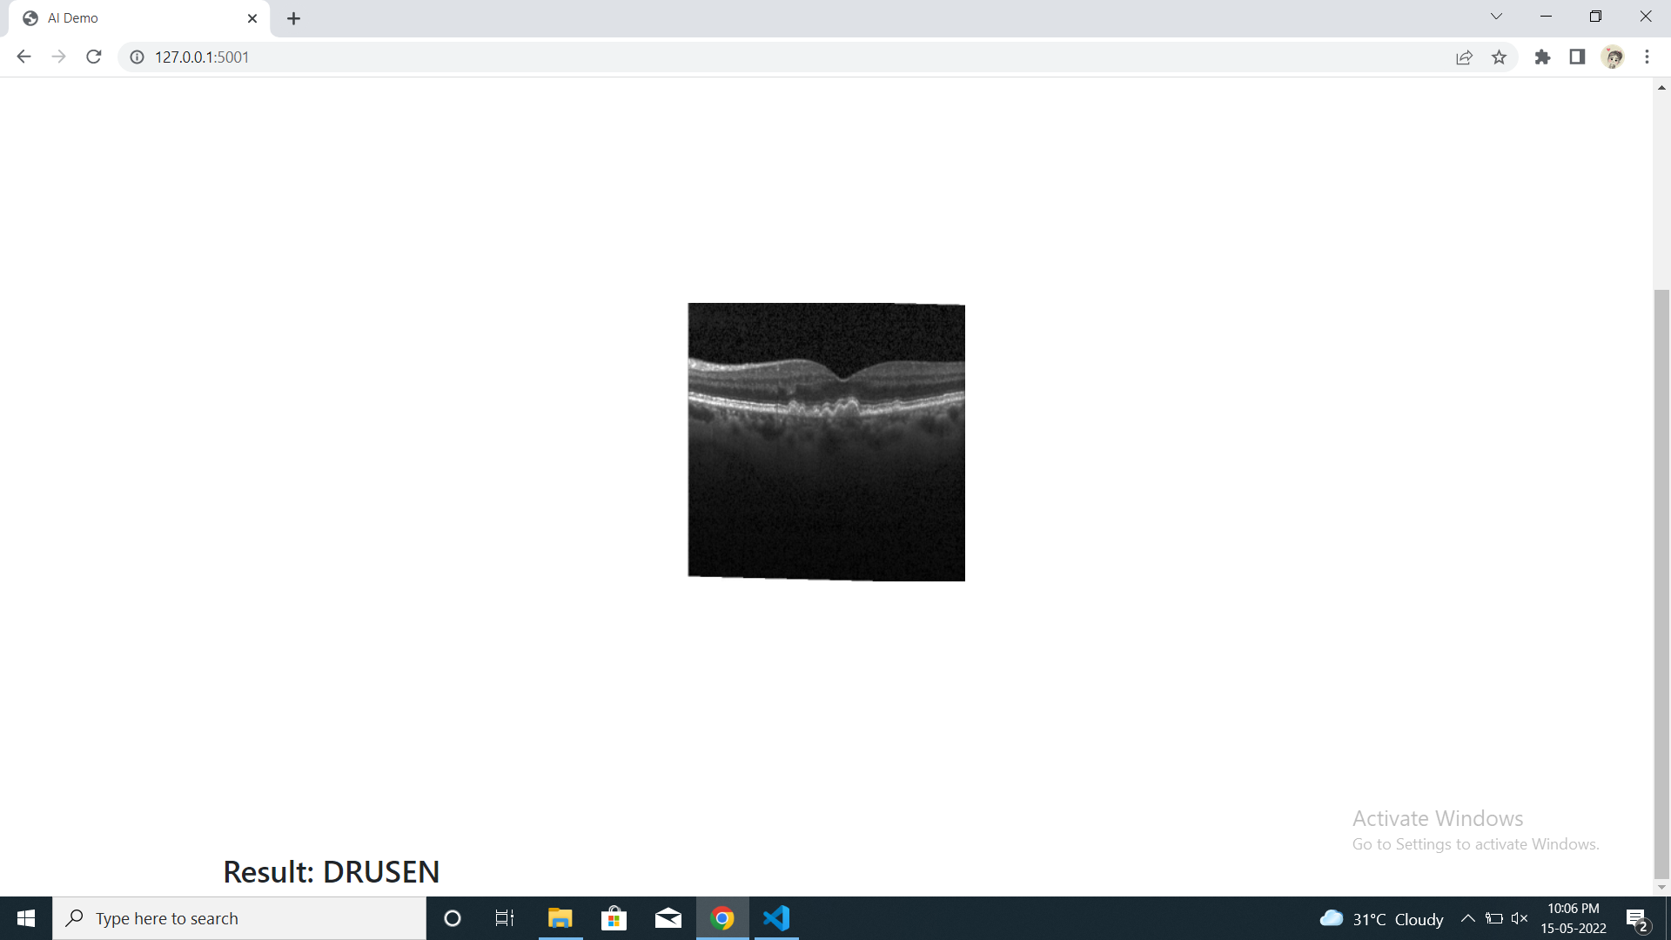
OUTPUT SCREENSHOT:
DRUSEN DETECTED

Slide 23
Conclusion:
Automated screening systems significantly reduce the time required to determine diagnoses, saving effort and costs for ophthalmologists and result in the timely treatment of patients. This system heavily impacts and possibly reduces the possibility of lags and any more inefficiencies that existed.
Automated systems for DR detection play an important role in detection of the DR images due to its accuracy and efficiency.
Statistical values can predict level of severity properly but in case of noisy images the chances of getting poor data will lead to lower accuracy. For yielding accurate result, selecting proper features out of the image is also important.
In future works we can compare the performance of this method with other updated CNN methods and with that of human experts.

Slide 24
References:
Aryan Kokane, Gourhari Sharma, Akash Raina, Shubham Narole, Prof. Pramila M. Chawan, "Detection of Diabetic Retinopathy using Machine Learning" in International Research Journal of Engineering and Technology (IRJET), 2020
Wejdan L.Alyoubi, Wafaa M.Shalash, Maysoon F.Abulkhair, "Diabetic retinopathy detection through deep learning techniques: A review" in Informatics in Medicine Unlocked, 2020
Yung-Hui Li , Nai-Ning Yeh, Shih-Jen Chen and Yu-Chien Chung, "Computer- Assisted Diagnosis for Diabetic Retinopathy Based on Fundus Images Using Deep Convolutional Neural Network" in Mobile information systems, 2019
Suvajit Dutta, Bonthala CS Manideep, Syed Muzamil Basha, Ronnie D. Caytiles and N. Ch. S. N. Iyengar, "Classification of Diabetic Retinopathy Images by Using Deep Learning Models" in International Journal of Grid and Distributed Computing, 2018
T Chandrakumar, R Kathirvel, "Classifying Diabetic Retinopathy using Deep Learning Architecture" in International Journal of Engineering Research & Technology (IJERT), 2016
J.Lachure, A.V.Deorankar, S.Lachure, S.Gupta, R.Jadhav, ―Diabetic Retinopathy using Morphological operations and Machine Learning‖, IEEE International Advance Computing Conference(IACC), (2015)
R.Priya, P.Aruna, ―SVM and Neural Network based Diagnosis of Diabetic Retinpathy‖, International Journal of computer Application

